Slide 1
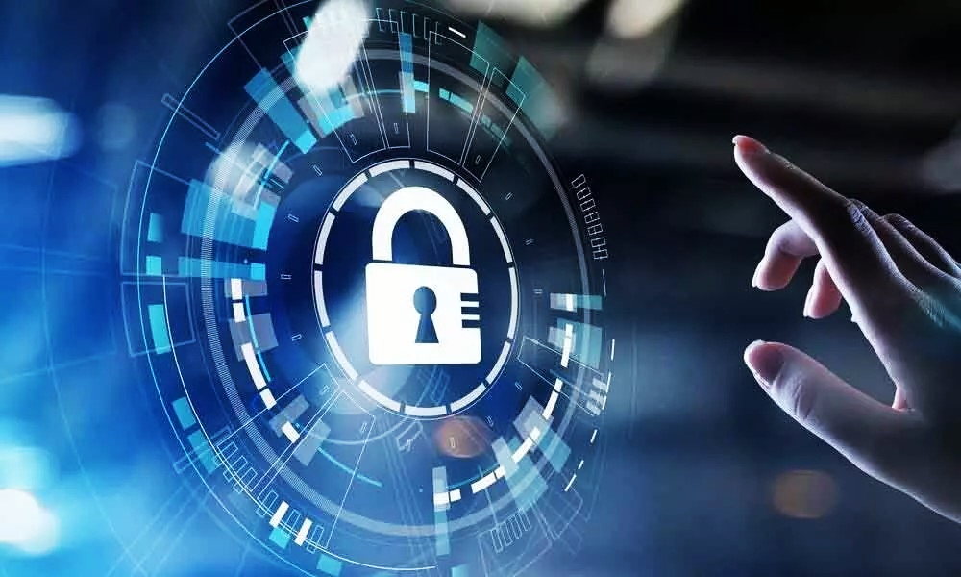
Topic : - Cybersecurity in the Digital age

Slide 2



Meet our Team
Akshay Funde
Dipesh Singh
Jayesh Tarvatkar

Slide 3
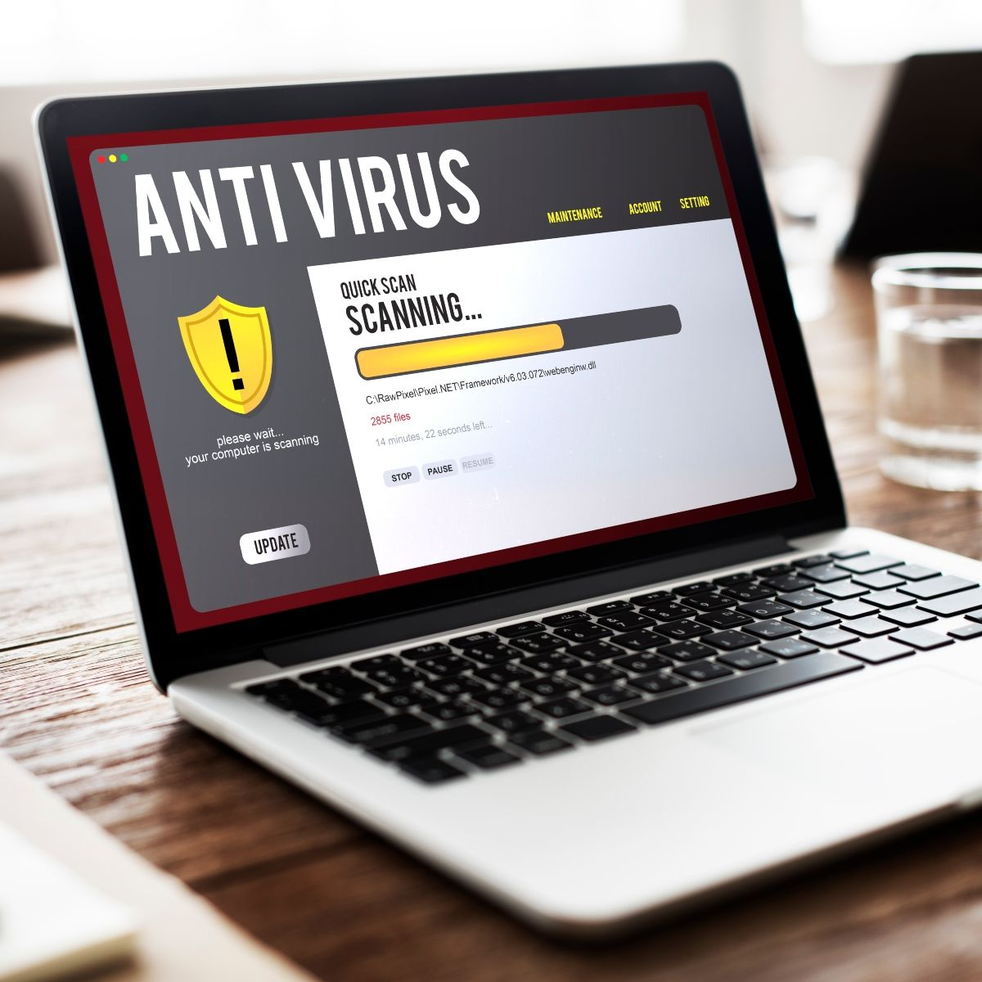
What is Cybersecurity?
Cybersecurity refers to the practices, technologies, and processes designed to protect systems, networks, and data from unauthorized access, use, disclosure, disruption, modification, or destruction.
It's an ongoing battle against cyber threats, which are malicious attempts to exploit vulnerabilities for personal gain or disruption.

Slide 4
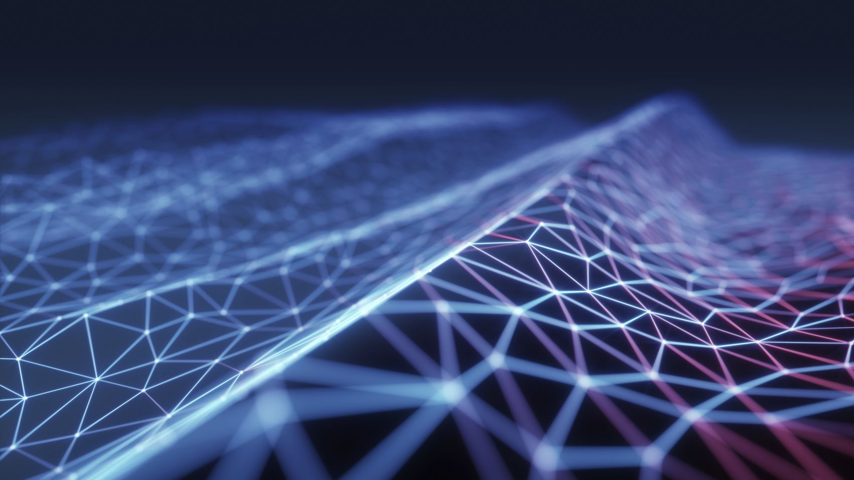
Through the Ages: The Evolution of Cybersecurity
1960s-70s
First cyber-attacks
1980s
First firewall technology (Packet Filter)
2000s
Advent of the World Wide Web
Rise of Mobile Devices, IOT, & Cloud Computing
2020s
COVID-19 Spread
Today
Potential cyber security using AI
1990s
Rise of virus and worm
2010s

Slide 5
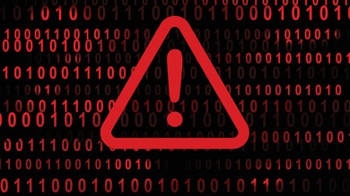
Facing the Enemy: Common Cyber Threats
Malware:
Worms: Malicious software that spreads rapidly through networks, exploiting vulnerabilities.
Trojans: Disguised as legitimate software, they grant attackers access to systems once downloaded.
Phishing
Spear phishing: Targets specific individuals or organizations with personalized messages.
Smishing: Phishing attempts delivered via SMS text messages.
Vishing: Phishing attempts made through phone calls.
Ransomware
Can target individuals, businesses, and critical infrastructure.
Disrupts operations and can cause significant financial losses.
Viruses: Self-replicating programs that infect and damage computer systems.

Slide 6
Facing the Enemy: Common Cyber Threats
Data Breaches
SQL injection: Submitting malicious code into a vulnerable website search box
Can result in identity theft, financial fraud, and reputational damage.
Social Engineering
Often involves impersonation, creating a sense of urgency, or playing on emotions.
Can be used to gain access to systems, steal data, or launch other attacks.
Zero-day exploit
Attacks that exploit vulnerabilities in software that the software vendor is not aware of.
Exploiting human psychology to manipulate users into giving away information or access.
Can occur due to various factors, including vulnerabilities in systems, human error, or cyberattacks.
Hits after a network vulnerability is announced but before a patch or solution is implemented.
Zero-day vulnerability threat detection requires constant awareness

Slide 7
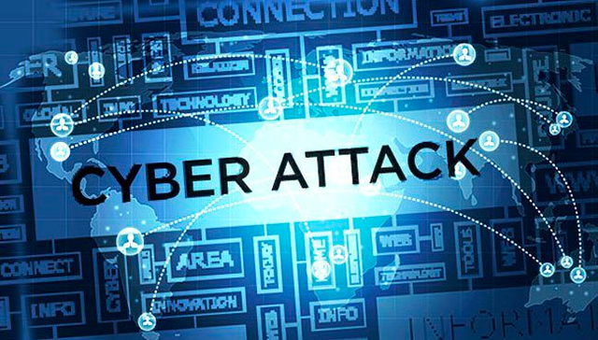
Major Cybersecurity Breaches
The Yahoo Attack (2014):
Approximately 500 million accounts were hacked
Ukraine Power Grid Attack (2015)
The event resulted in power outages for around 230,000 customers across the Ukraine for between 1 and 65 hours.
Equifax Breach (2017):
147 million Social Security numbers exposed due to a vulnerability in a web application.
Impacted credit scores and financial security of millions
WannaCry Ransomware Attack (2017):
Global ransomware attack infected hundreds of thousands of computers, demanding ransom payments.
Disrupted hospitals, businesses, and government agencies worldwide demanding ransom payments.
Marriott Hotel Data Breach (2018)
Massive database breach revealing the personally identifiable information of around 500 million guests.k

Slide 8
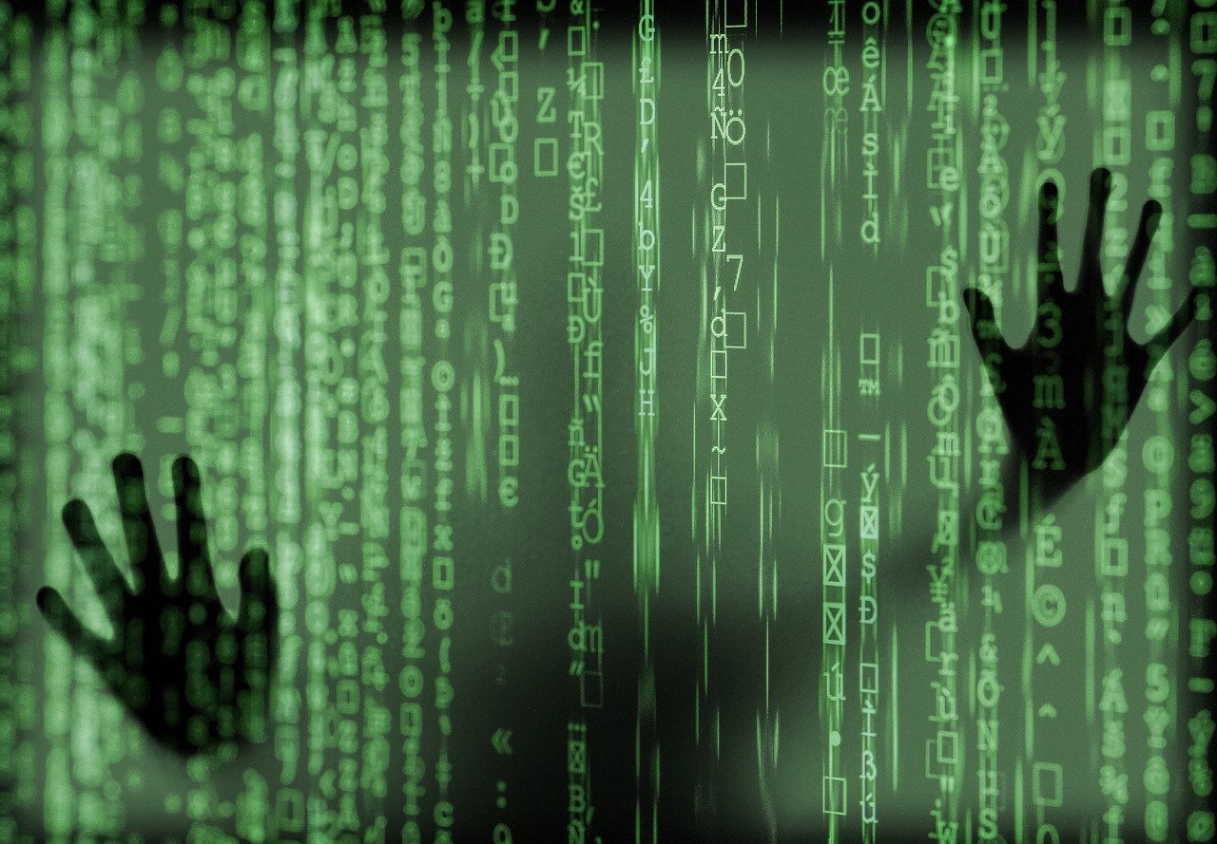

Impact of Cyber Attacks on Individual
Financial Loss and Identity Theft
most immediate and tangible impacts of cyber-attacks
hackers employ various techniques
bank accounts emptied
Damage to Reputation and Relationships
considerable harm to their personal and professional lives.
restoring trust can be an uphill battle after such an incident.
Loss of Trust in Digital Services and Technology
individuals may lose trust in digital services and technology.
deter individuals from adopting new technologies

Slide 9
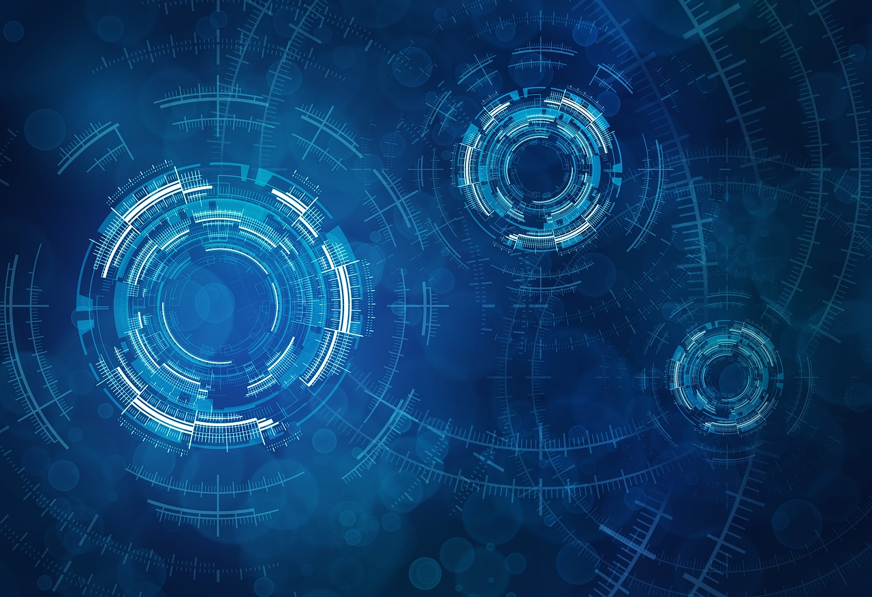
Impact of Cyber Attack on Businesses
Increased Costs
Operational Disruption
Cyber attacks often leads to possibility of a major interruption to operations that can result in lost revenue.
Reputational damage
Trust is an essential element of a customer relationship. Cyber attacks can damage business reputation and erode the trust customers have for the company. This can result In
loss of customers
loss of sales
reduction in profits
Shut Down of Company
According to a data, 60 percent of small companies go out of business within six months of falling victim to a data breach or cyber attack.
According to a data of 2019, 6% of companies had to pay a ransom to the attacker.
In 2010, hackers retaliated credit cards giant Visa and Mastercard, by conducting an attacks that temporarily crashed their websites.
In fact, one of the biggest bitcoin exchange of it's time, MT Gox, which accounted for almost 70% of total bitcoin transactions at the time, was shut down after the hackers stole thousands of Bitcoin from company.
Companies that want to protect themselves from online thieves have to spend a lot of money in cybersecurity technology and expertise, insurance premiums, pay ransom amount.

Slide 10
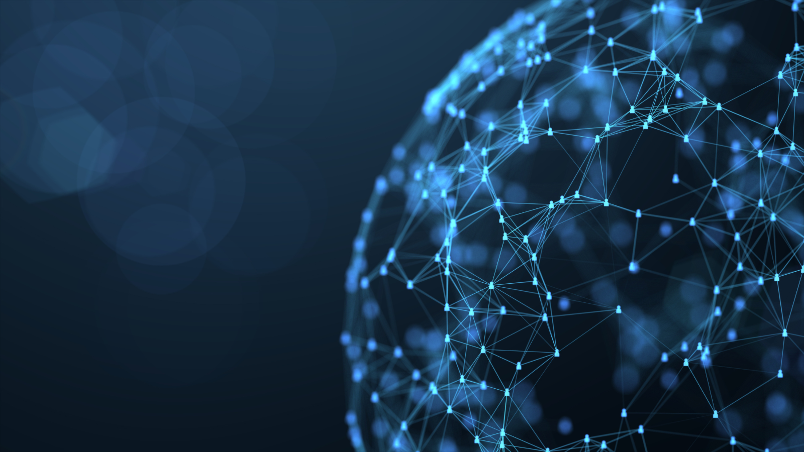
Emerging Future Trends in Cyber Security
AI and ML Technologies
Cloud Computing
Blockchain Technologies
enable organizations to automate data analysis and detect patterns and anomalies at a faster rate than when using traditional procedures.
can be used to automate a number of tasks, helping to reduce workloads and reduce organizational costs.
cuts costs by removing the need for hardware or software maintenance, as this will be provided by the provider of the cloud-based service.
can help to lower software deployment times, as organizations can build and launch new software and programs without needing to spend time building the infrastructure needed to support them.
decentralization makes it much more difficult for cyber criminals to compromise the network, which is why it’s becoming an increasingly popular choice for applications that require high levels of security.
has been predominantly adopted within industries such as government, healthcare, finance and real estate where the risk of data breaches and fraud can have serious consequences.

Slide 11
Emerging Future Trends in Cyber Security
Quantum Computing
most of the ways we keep information safe in cybersecurity rely on the fact that some math problems are really hard for regular computers to solve.
quantum computers are super good at solving these problems quickly, which could make the old ways of keeping data safe not work so well.
on the other hand, they could also help us make new and super secure ways to protect information, which would be great for keeping important stuff safe.

Slide 12
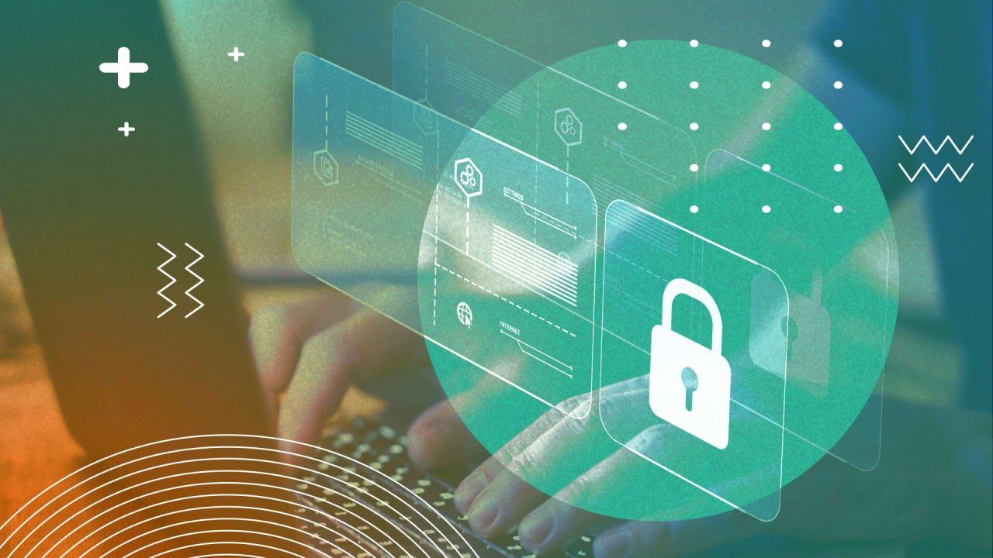
Building a Culture of Cybersecurity
To ensure strong data protection, organizations need more than basic security measures like firewalls and anti-malware software.
regular campaign about the effective ways to be safe from cyber attacks and threads
just as fire drills and practice first aid, data breach or other cyber attack drills can help employees fill knowledge gaps and feel more confident about their ability to respond to cyber threats.
Robust Cybersecurity Training
need tailored training to help promote defensive strategies against vulnerabilities in business sector.
phishing attacks are among the most common attack vectors, relying on human error and negligence
Conduct Cybersecurity Campaigns
these campaigns can be relayed through various means like emails, videos, blog posts, social medias.
Conduct Cybersecurity Drills
simulating phishing attacks can evaluate the effectiveness of the cybersecurity policies, procedures, messages, and training

Slide 13
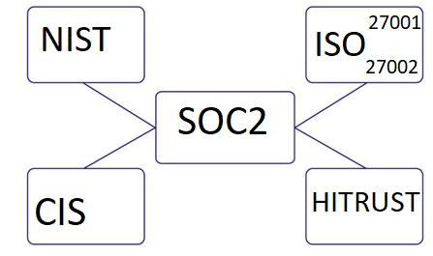
Cyber Security Frameworks
A cyber security framework is a set of policies and procedure implemented to create an effective security posture

Slide 14
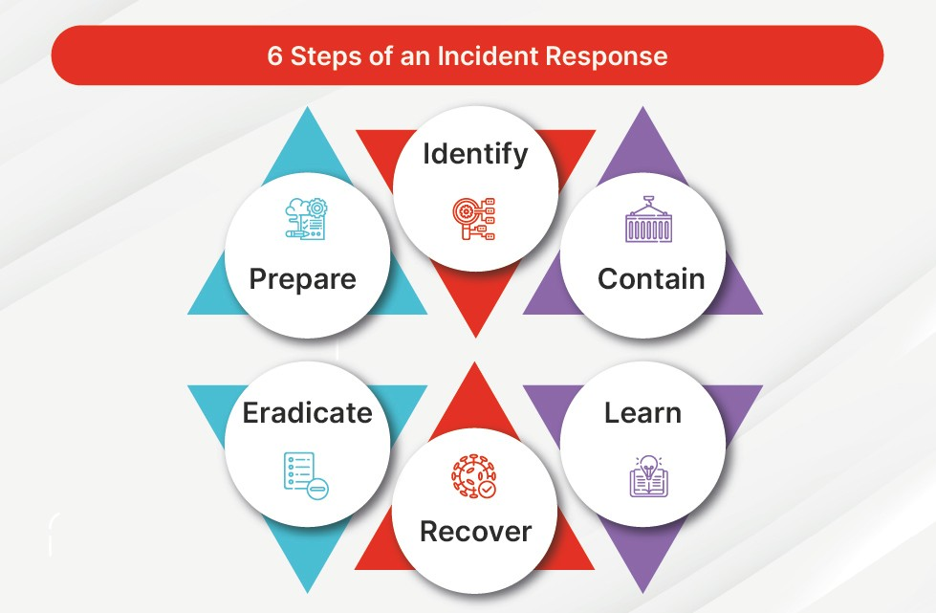
Cybersecurity Incident
Response
Incident response is the strategic, organized response of an organization following a cyberattack

Slide 15
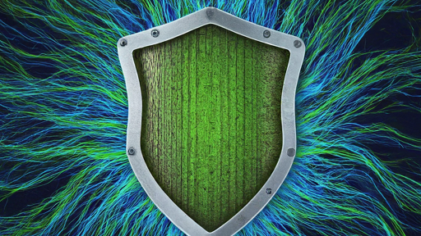
Summary
Shield Your Data: Use strong passwords, MFA, and software updates.
Outsmart Scams: Be wary of phishing, verify links, and educate yourself.
Embrace AI Defense: Leverage AI tools for threat detection and proactive protection.
Stay Vigilant: Cybersecurity is an ongoing journey, stay informed and adapt.

Slide 16


